Slide 1
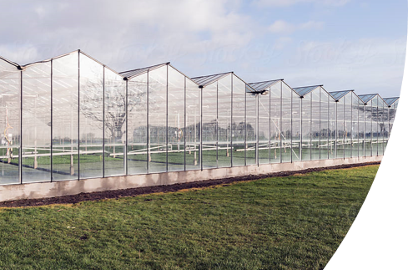
Sin Greenhouse
Projectweek 2022 - Sprint 2

Slide 2
The Problem
Problem Statement
What problem is the project trying to solve?
The problem that we must solve is in an industrial environment of, for example, a farmer, the environmental variables must be displayed, and an attempt must be made to secure it.
So, what now:
Convert float to data on webserver
Running webserver on RPI instead of pc
Adjusting data on plc with freeOPC with help of weather api
What is special about the project?
Manipulate data that allows the motor and heating element to change state
Problem

Slide 3
Goal
Goal
What is the main goal of the project?
Manipulate states of devices on the PLC by sending data to the PLC.
What are secondary goals of the project?
(use a figure if possible)
Securing the system so that the data can no longer be manipulated.
Connect analog temperature sensors for comparison.
By building an extra webpage where one can see how many packets of data are sent over mqtt. the number of connected clients etc.
Goal

Slide 4
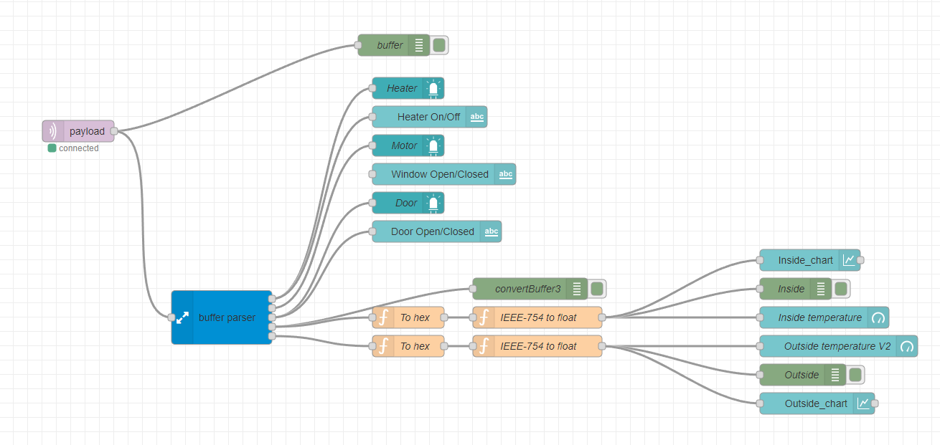
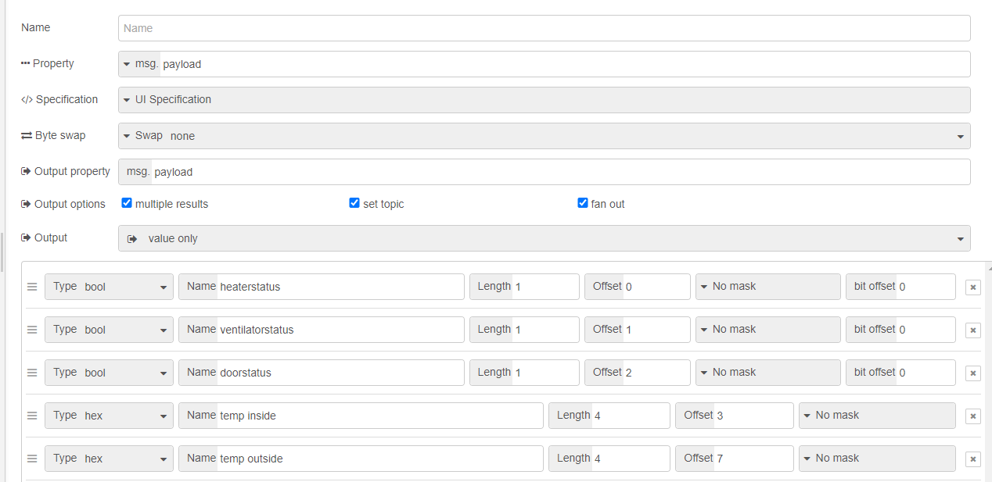
Analysis
Analysis
What are the constraints of the problem?
Everything must run on the RPI.
Which criteria are important, which are nice to have?
Data can be adjusted quickly
Data is displayed well.
Which technological solutions exist for these constraints / criteria?
Keeping a good overview. Occasionally ask around if data is coming across well to the customer.
Analysis

Slide 5
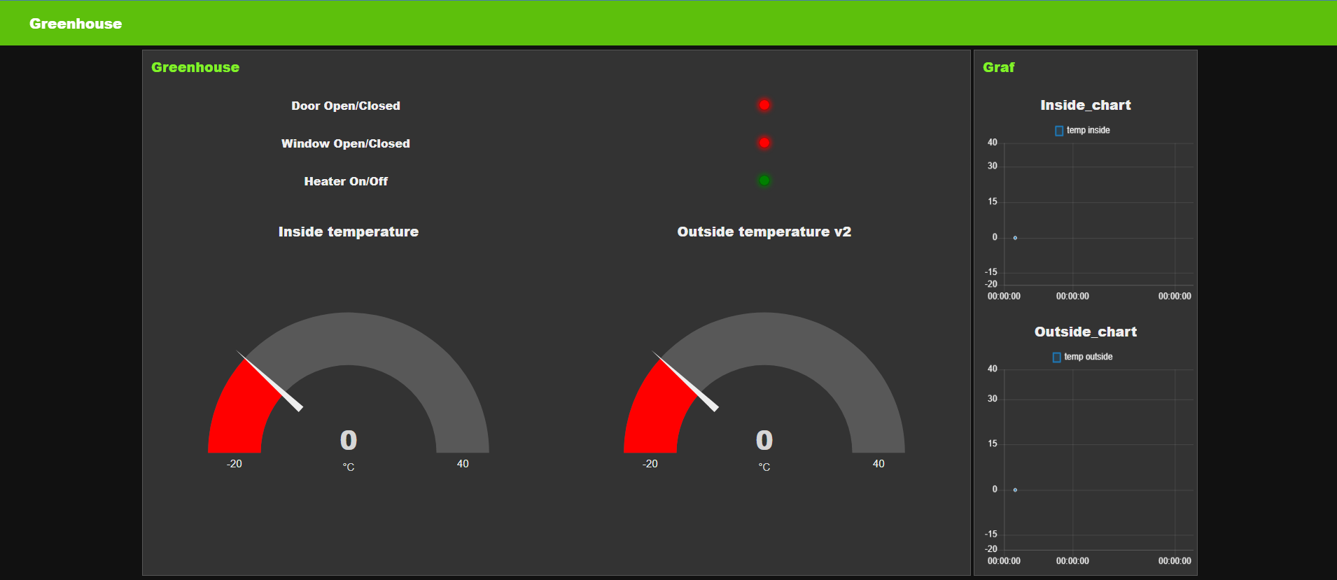
Node-Red
Dashboard
Dashboard

Slide 6
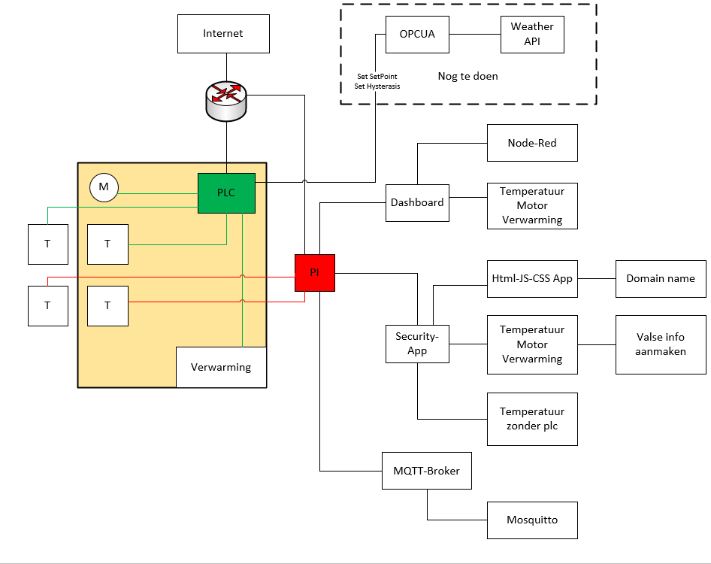
Scheme
Implementation
Overview of the Greenhouse

Slide 7
To Do
Future Work
What are the goals for the next sprint?
- Adjusting data on plc with freeOPC
Who is going to do what?
If this is the last sprint, describe what could be improved or what you could do if you had more time.
We would like to secure the mqtt broker with username and password
Use network monitor system (Mqtt watcher) on webpage.

